Slide 1

Sun, moon, earth
Dance and eclipses
The NASA Eclipse Ambassador program
Khady Adama Ndao ndaokhadyadama244@gmail.com
Daniel Marcel Roy danr@astronomyhouston.org

Slide 2

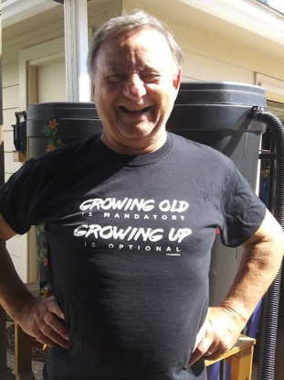
About the eclipse ambassador program
NASA program with Astronomy Society of the Pacific partners
Pairing a student with an experienced astronomer
Going through 12h of instruction as a team
Putting together outreach programs
Designed to encourage STEM studies
Ensuring safe public participation in astronomical events
Fostering diversity within the teams and in the field
Making it fun for all ages

Slide 3
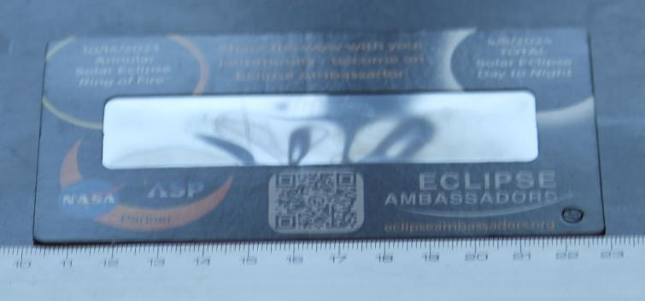
Our program
Safety briefing and safety glasses distribution

Slide 4
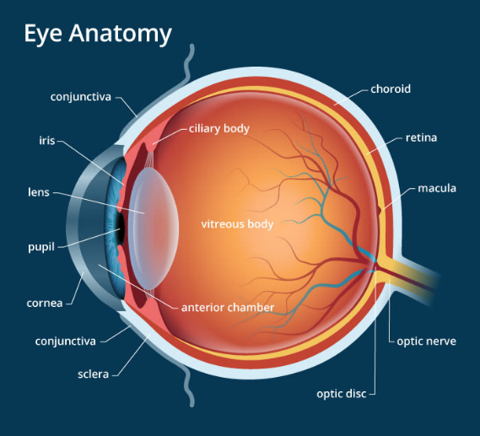
Danger to the eye
Ultraviolet light may literally burn part of your retina on the spot
Even short exposure may result in long term, even permanent dark or yellow spots (solar retinopathy)
The retina does not have any pain-receptors, you will not feel the burn
The cornea can also be sunburn (solar keratitis). Light sensitivity and pain, will show up within 24 hours of exposure
Notes:
several hours (or even days) later, when people find their eyes hurt, their vision is blurred or that dark or yellow spots are affecting their sight that they realise damage has occurred. Most people who experience solar keratitis and solar retinopathy make a full recovery but, depending on the level of damage, this can take up to 12 months. Others never fully recover complete vision, and continue to experience vision problems such as blurriness or spots.

Slide 5
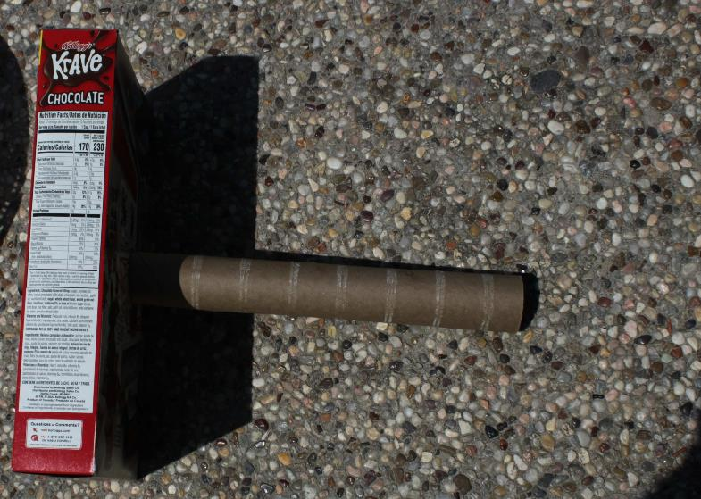
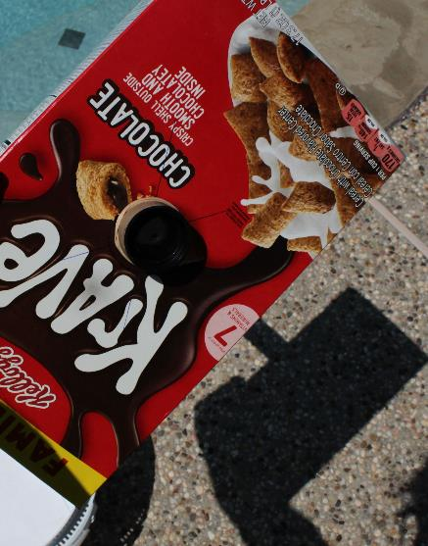
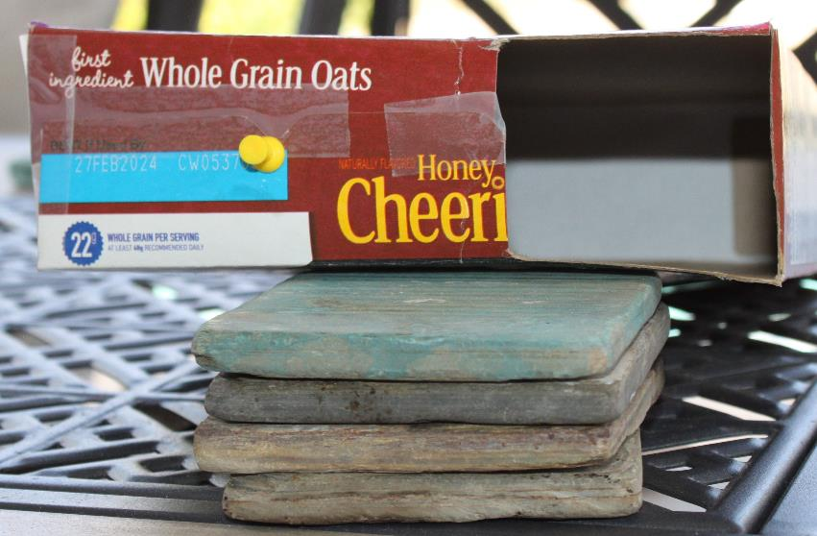
A few safe ways

Slide 6
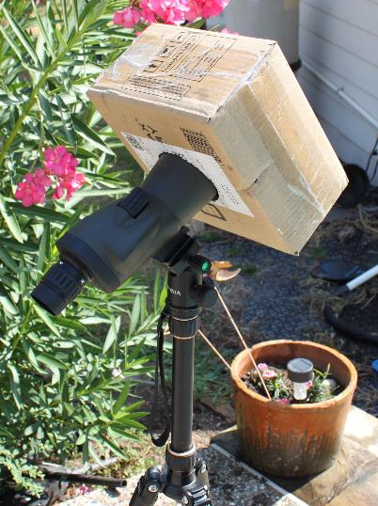
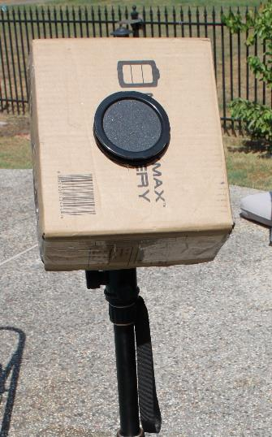
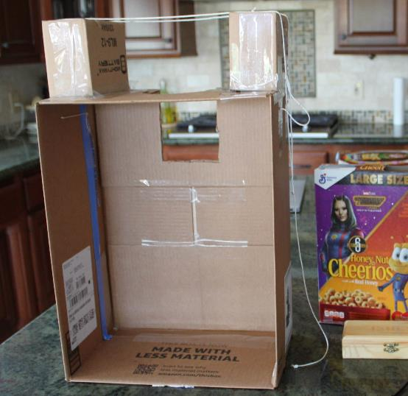
Have fun

Slide 7
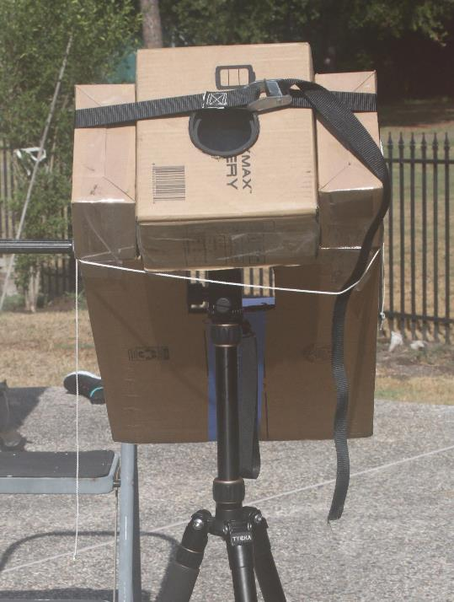
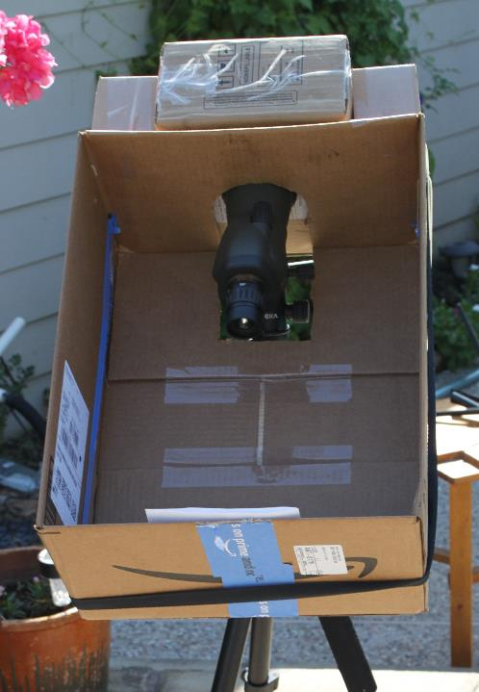

Slide 8
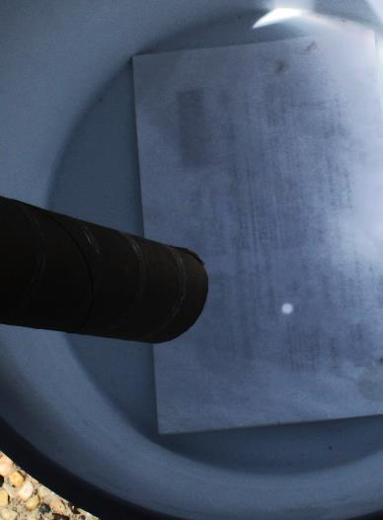
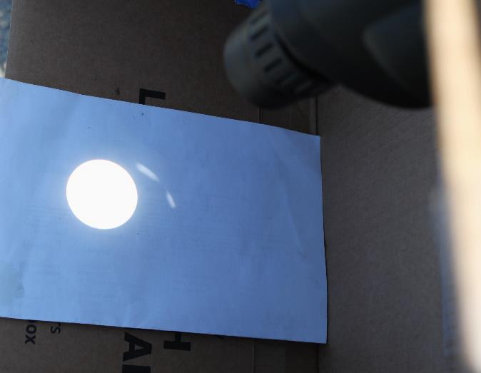
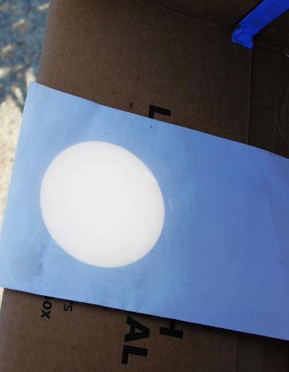
Watch safely
X20
X60

Slide 9
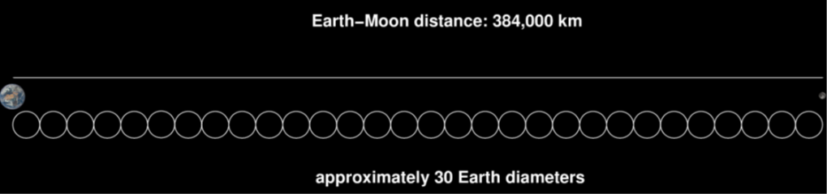
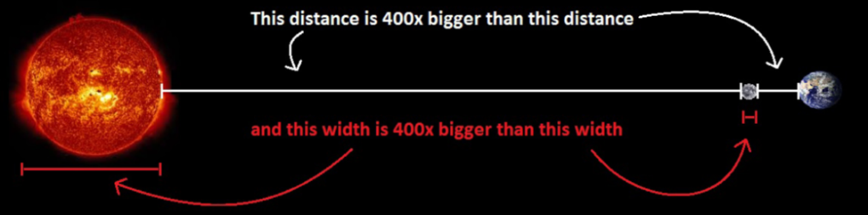
Our program
Safety briefing and safety glasses distribution
Hands on demonstration of the sun earth moon dances
Sun earth moon distances
From ASP Scale model activities

Slide 10
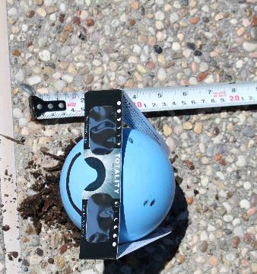
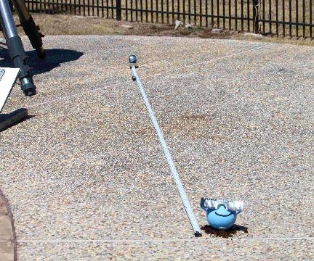
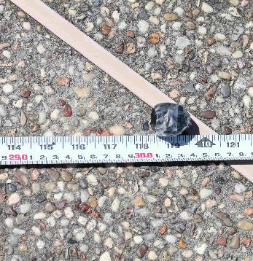
Our program
Safety briefing and safety glasses distribution
Hands on demonstration of the sun earth moon dances
Sun earth moon distances

Slide 11
Our program
Safety briefing and safety glasses distribution
Hands on demonstration of the sun earth moon dances
Sun earth moon distances
Moon phases

Slide 12
Our program
Safety briefing and safety glasses distribution
Hands on demonstration of the sun earth moon dances
Sun earth moon distances
Moon phases
Lunar eclipse

Slide 13
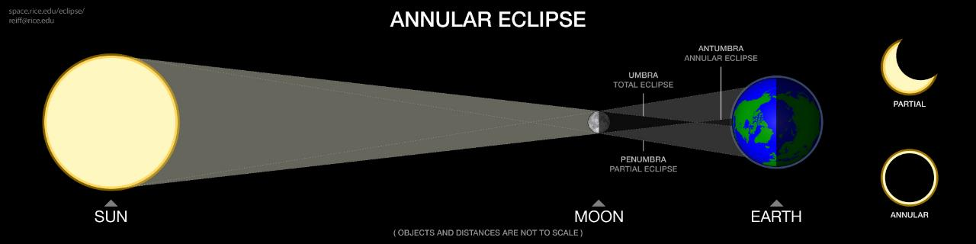
Solar/Lunar Eclipse 101
If the Moon is too far away to cover the entire Sun we get an annular eclipse:
Moon at apogee (farthest from Earth) and/or Earth at perihelion (closest to Sun)
Annular eclipse diagram (from http://space.rice.edu/eclipse )
reiff@rice.edu

Slide 14
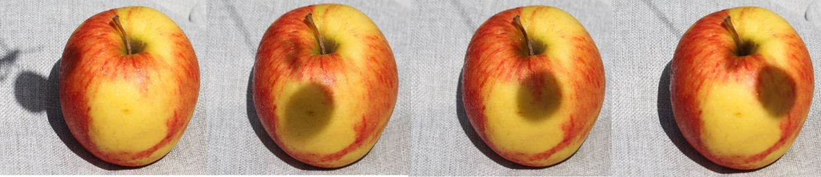
Our program
Safety briefing and safety glasses distribution
Hands on demonstration of the sun earth moon dances
Sun earth moon distances
Moon phases
Lunar eclipse
Solar eclipses partial, annular, total
Observing the eclipse
What to expect
Explanations and Q&A

Slide 15

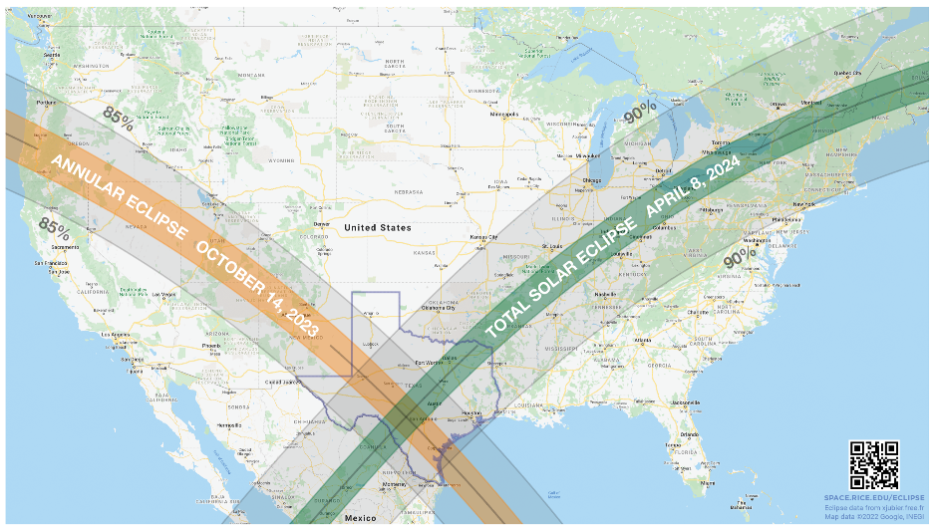
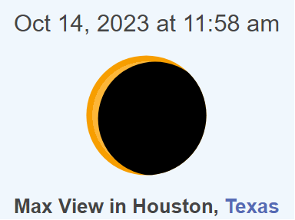
The orange band is the path of annularity
The green band is the path of totality
reiff@rice.edu
Notes:
The path of the 2023 Annular and 2024 Total eclipses

Slide 16
Our program
Safety briefing and safety glasses distribution
Hands on demonstration of the sun earth moon dances
Sun earth moon distances
Moon phases
Lunar eclipse
Solar eclipses partial, annular, total
Observing the eclipse
What to expect
Explanations and Q&A
Google “nasa eclipse ambassador”

